Slide 1

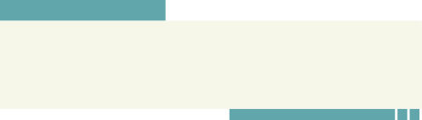

HOTEL RESERVATION ANALYSIS USING
Sql
Jagmeet Singh, Batch :- MIP-DA-10

Slide 2

Introduction
Project Objective: Analyzing hotel reservations csv file using SQL
Importance of project : Applying analytical skills in practical application
Dataset : Hotel reservations details in key columns and their significance

Slide 3


PROJECT FLOWCHART
Import CSV file into database
Analyze the dataset
Getting insights from dataset

Slide 4

DATASET
The dataset includes the following columns:
Booking_ID: A unique identifier for each hotel reservation.
no_of_adults: The number of adults in the reservation.
no_of_children: The number of children in the reservation.
no_of_weekend_nights: The number of nights in the reservation that fall on weekends.
no_of_week_nights: The number of nights in the reservation that fall on weekdays.
type_of_meal_plan: The meal plan chosen by the guests.
room_type_reserved: The type of room reserved by the guests.
lead_time: The number of days between booking and arrival.
arrival_date: The date of arrival.
market_segment_type: The market segment to which the reservation belongs.
avg_price_per_room: The average price per room in the reservation.
booking_status: The status of the booking.

Slide 5

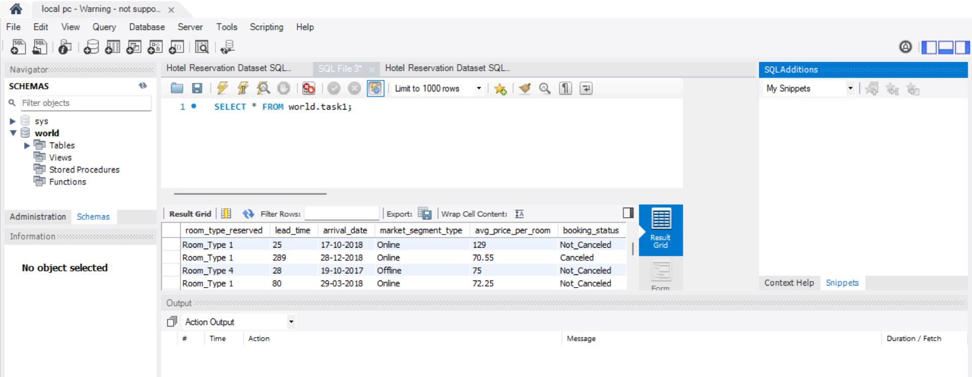
MySQL Workbench

Slide 6

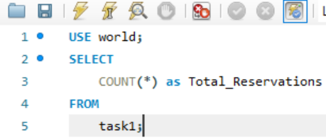

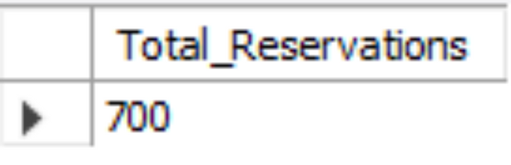
What is the total number of reservations in the dataset?

Slide 7

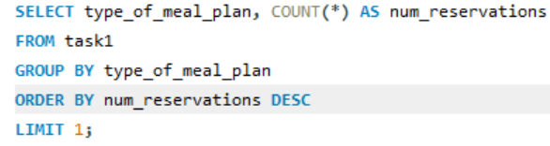
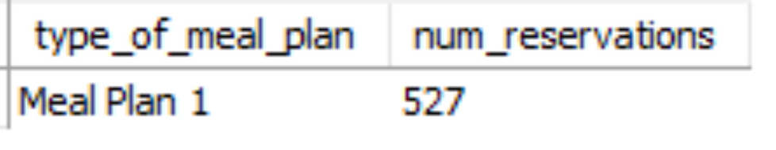
Which meal plan is the most popular among guests?

Slide 8

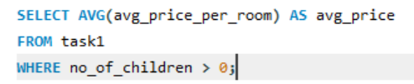
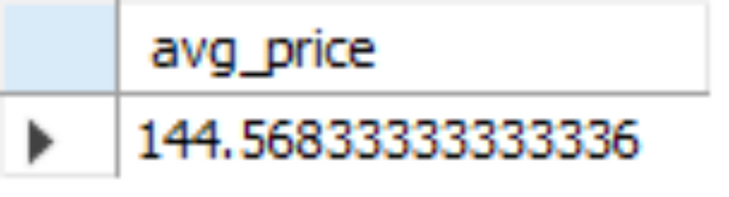
What is the average price per room for reservations involving children?

Slide 9

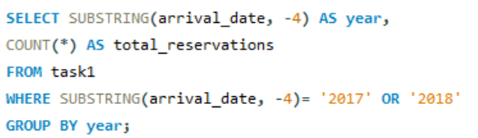
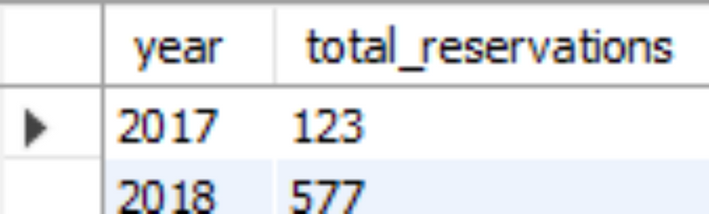
How many reservations were made for the year 20XX (replace XX with the desired year)?

Slide 10
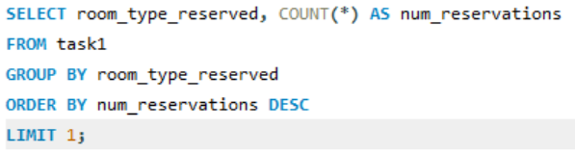
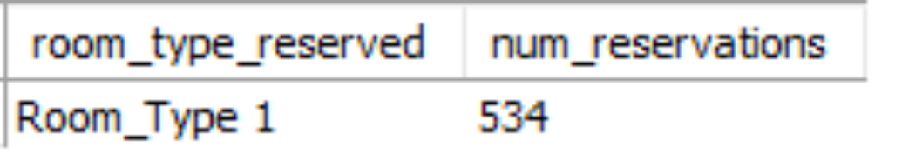
What is the most commonly booked room type?

Slide 11

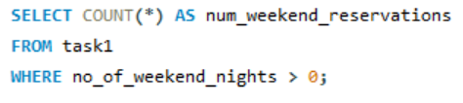
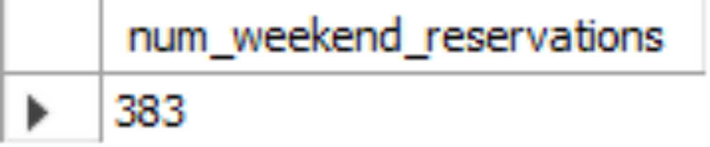
How many reservations fall on a weekend (no_of_weekend_nights > 0)?

Slide 12

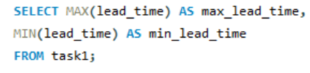
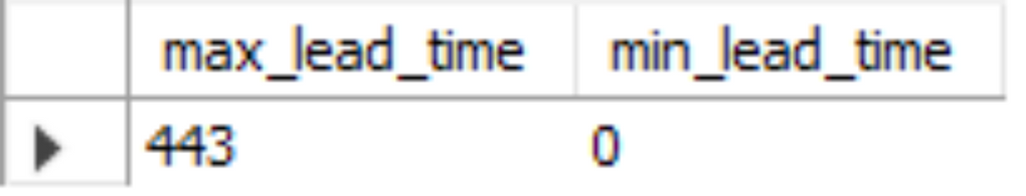
What is the highest and lowest lead time for reservations?

Slide 13

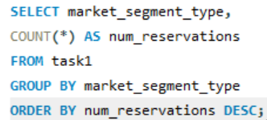
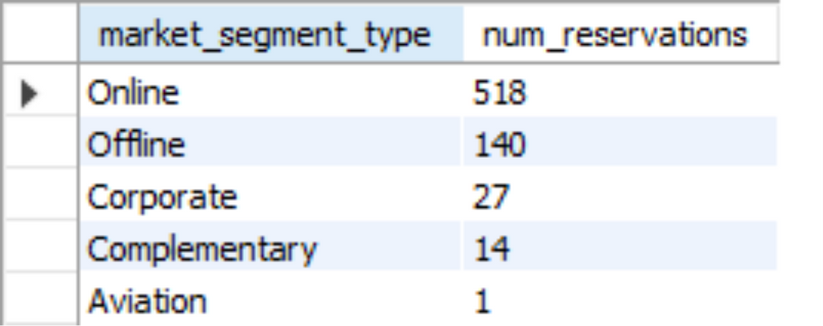
How many reservations fall on a weekend (no_of_weekend_nights > 0)?

Slide 14


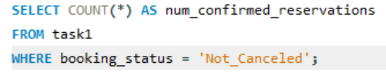
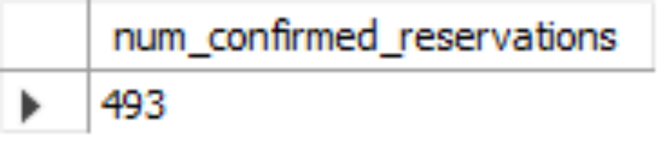
How many reservations have a booking status of "Confirmed"?

Slide 15
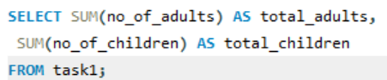
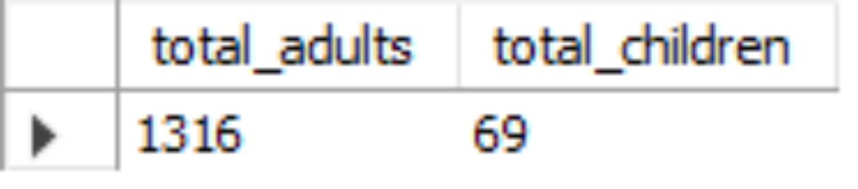
10
What is the total number of adults and children across all reservations?

Slide 16
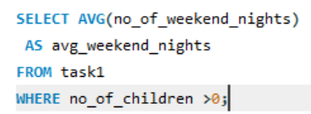
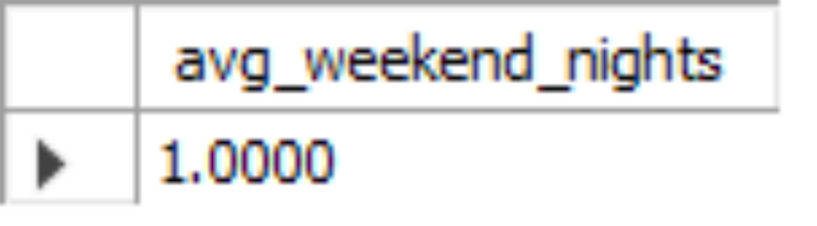
11
What is the average number of weekend nights for reservations involving children?

Slide 17
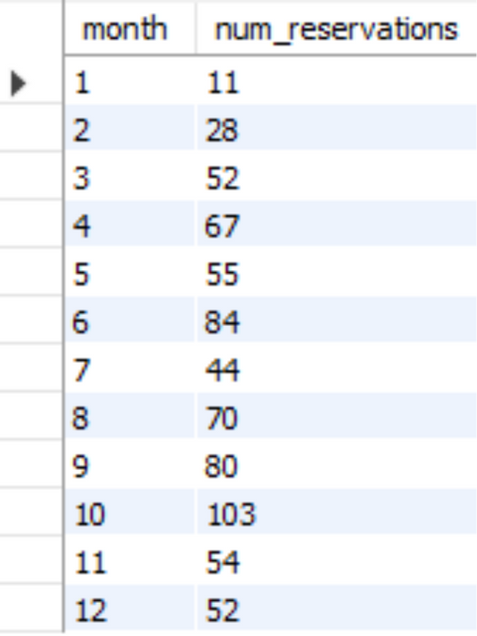
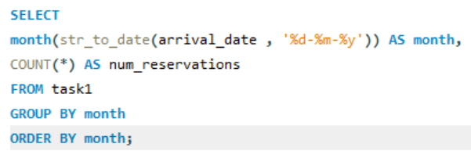
12
How many reservations were made in each month of the year?

Slide 18
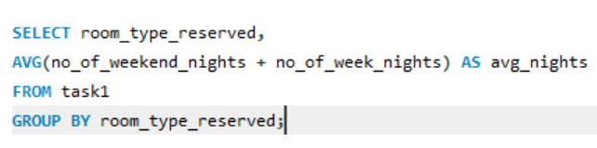
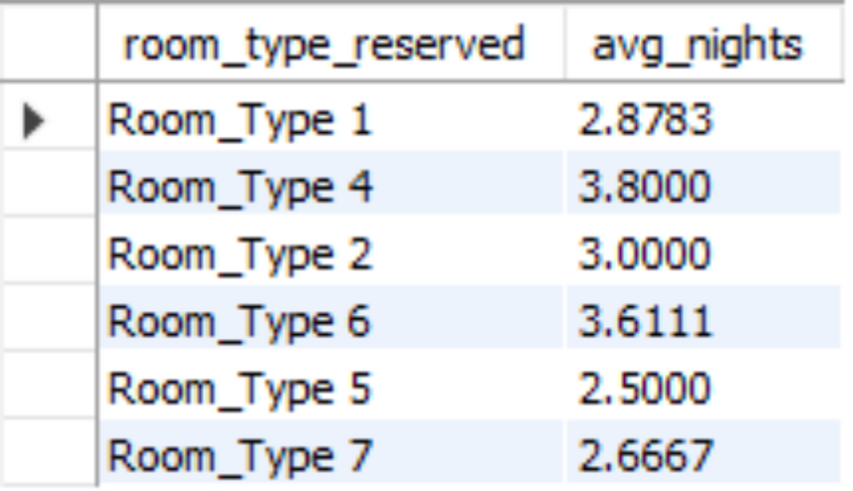
13
What is the average number of nights (both weekend and weekday) spent by guests for each room type?

Slide 19
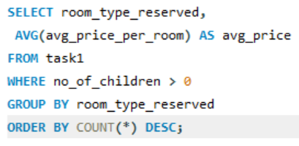
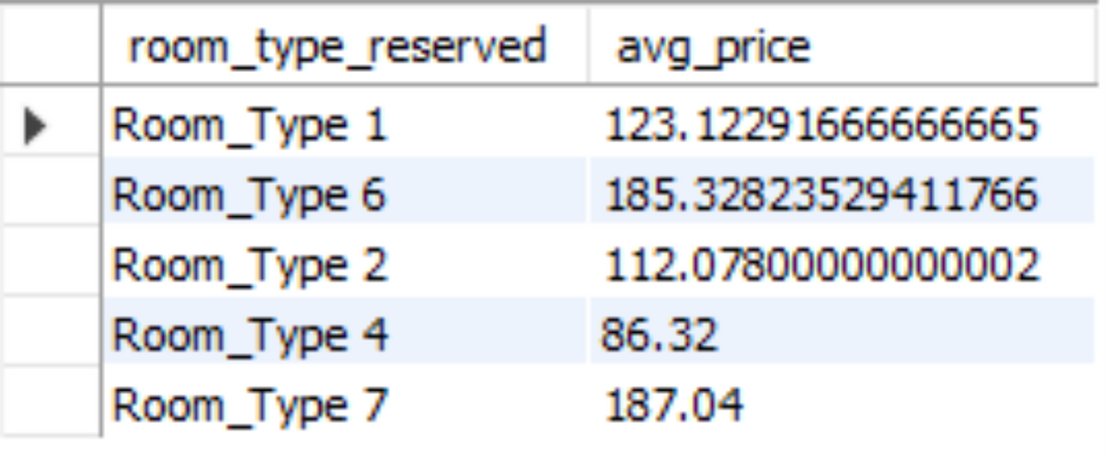
14
For reservations involving children, what is the most common room type, and what is the average price for that room type?

Slide 20
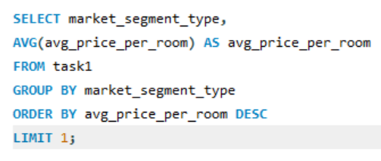
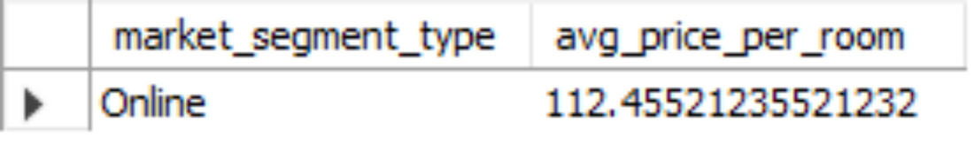
15
Find the market segment type that generates the highest average price per room.

Slide 21
outcomes
Strategic Decision-Making: By analyzing reservation patterns, hotels can adjust room rates dynamically.The analysis can guide marketing efforts
Enhanced Guest Experience: Knowing the most popular meal plan allows hotels to personalize guest experiences.
Revenue Optimization: Hotels can create attractive family packages or discounts for families with children. Additionally, they can optimize room configurations (e.g., adjoining rooms) to accommodate families.

Slide 22


SUMMARY
Resources
In summary, this analysis empowers hotels to make informed decisions, enhance guest satisfaction, and maximize revenue. By leveraging these insights, hotels can create a more efficient and guest-centric operation.

Slide 23

THANKS!

